Slide 1

Bachelor Of Science In Mathematics
DEPARTMENT OF MATHEMATICS
GOVERNMENT ARTS AND SCIENCE COLLEGE
THENNANGUR-604408
OCTOBER 2023

Slide 2

ANALYSING HOUSING PRICES IN METROPOLITAN AREAS OF INDIA
TEAM LEADER:
M.MANGAIYARKARASI
TEAM MEMBERS:
S.ARULKUMAR
E.GUNAL
B.VIKRAM
OUR MENTOR :
MR.R.SUDHAKAR
DEPARTMENT OF MATHEMATICS

Slide 3

ANALYSING HOUSING PRICES IN METROPOLITAN AREAS OF INDIA

Slide 4

INTRODUCTION :
House price prediction in a metropolitan city in India is a valuable solution for potential home buyers, real estate agents, and investors. By leveraging historical sales data, property details, and location-specific information, a predictive model can accurately estimate house prices.

Slide 5

OVER VIEW :
Bengaluru too witnessed a 10 per cent increase in prices to ₹8,688 per square feet. The prices of residential properties in Chennai went up 6 per cent to ₹7,653 per square feet. In Delhi-NCR, rates shot up 14 per cent to ₹8,652 per square feet. Housing prices in Hyderabad rose 13 per cent to ₹10,530 per square feet.09-Aug-2023

Slide 6

PURPOSE :
House price prediction in a metropolitan city in India is a valuable solution for potential home buyers, real estate agents, and investors. By leveraging historical sales data, property details, and location- specific information, a predictive model can accurately estimate house prices.

Slide 7
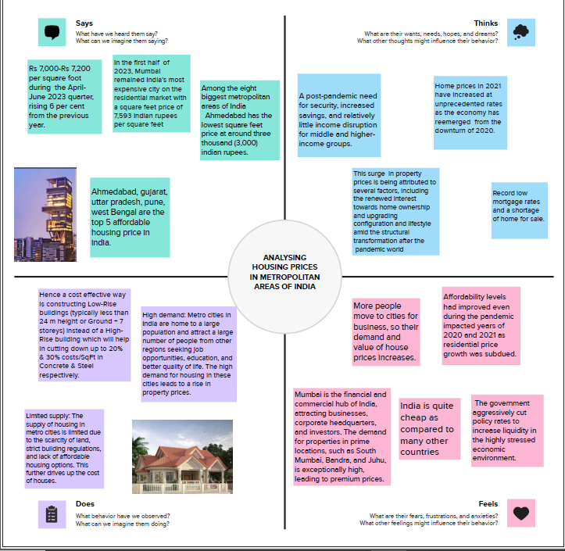

Slide 8
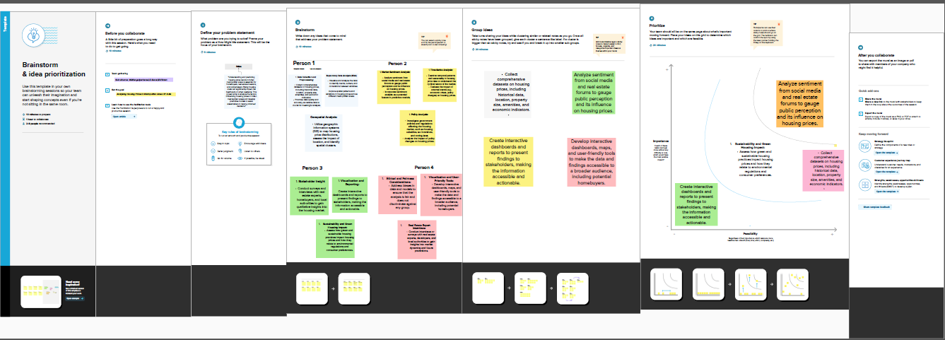

Slide 9
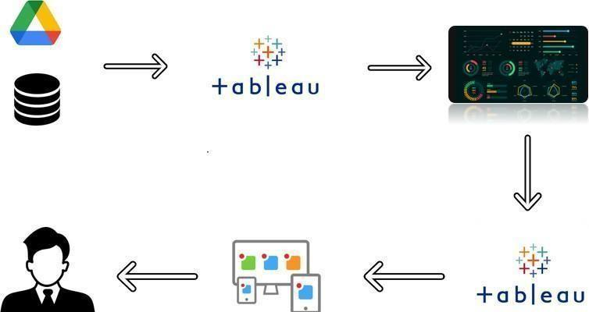

Slide 10
VISUALISATIONS

Slide 11
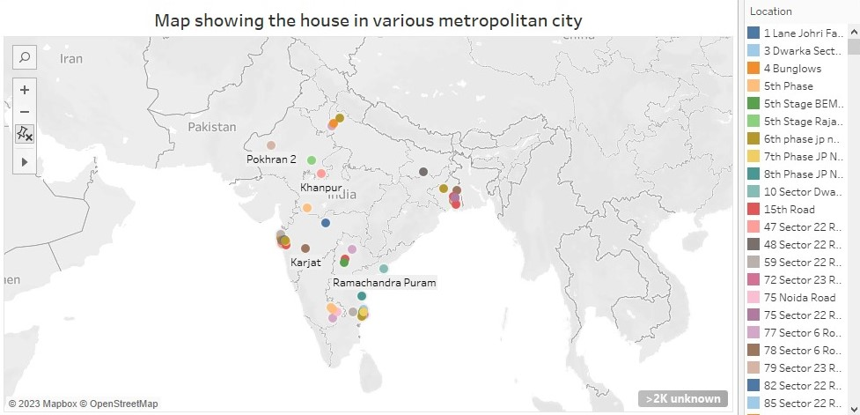

Slide 12
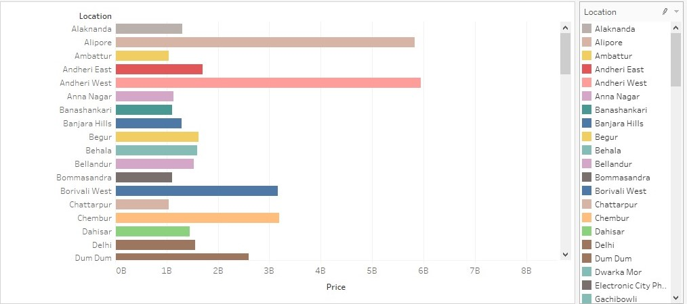

Slide 13
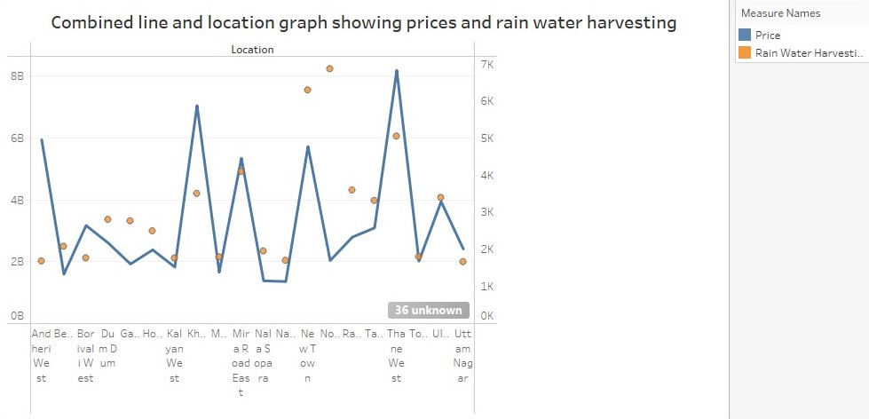

Slide 14
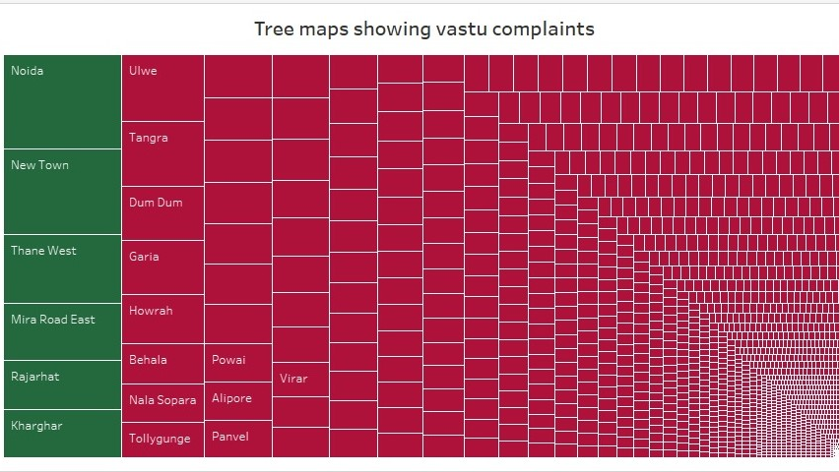

Slide 15
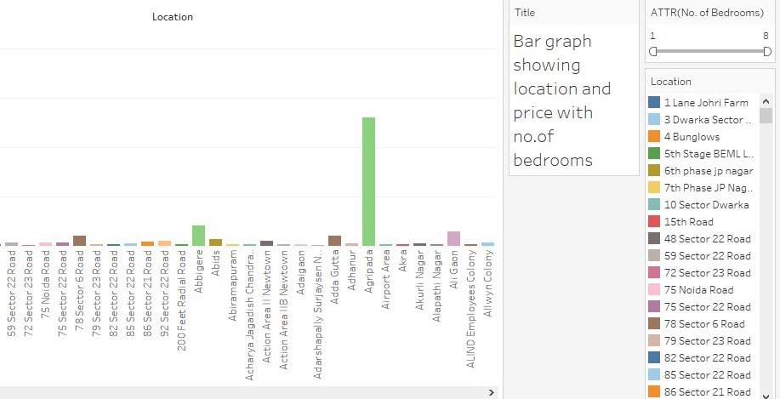

Slide 16
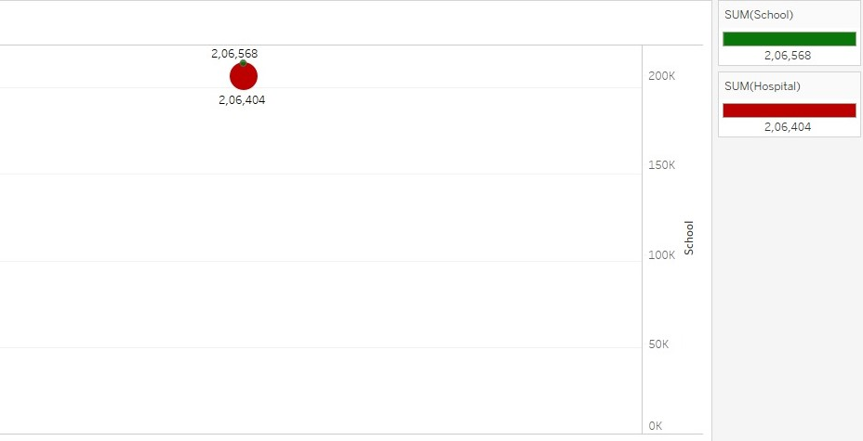

Slide 17
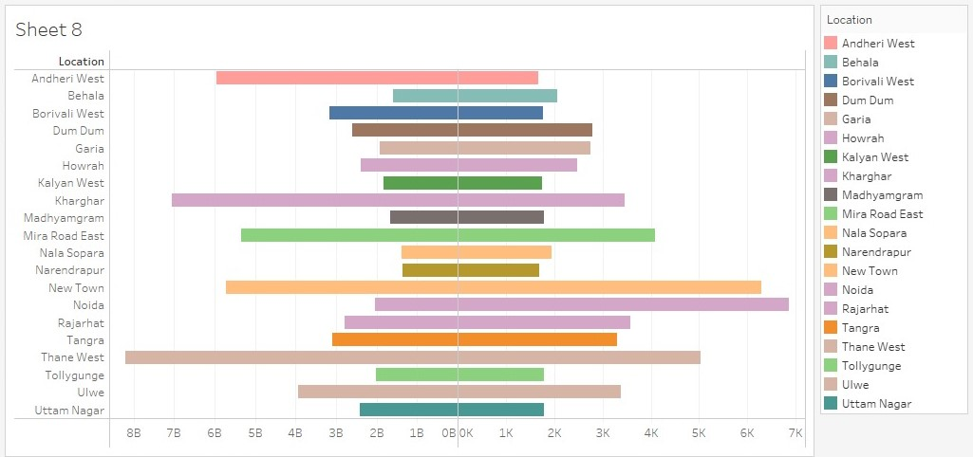

Slide 18
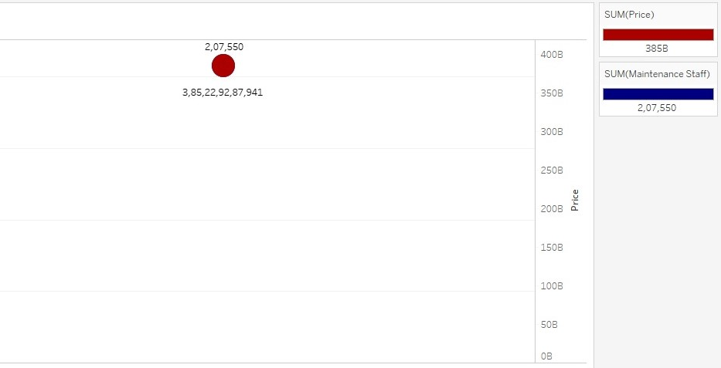

Slide 19
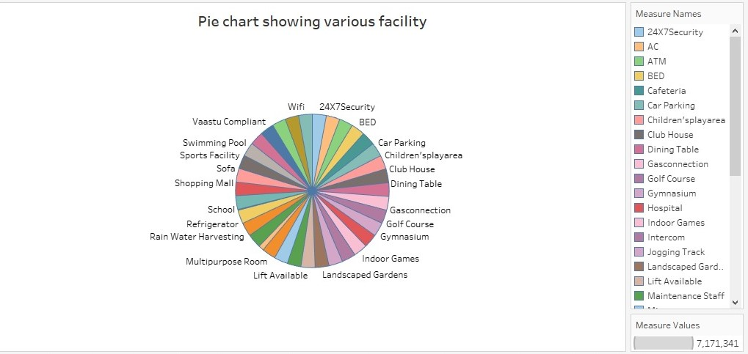

Slide 20

DASHBOARDS

Slide 21
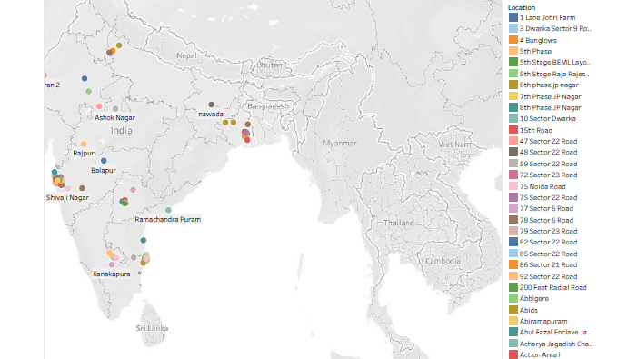

Slide 22
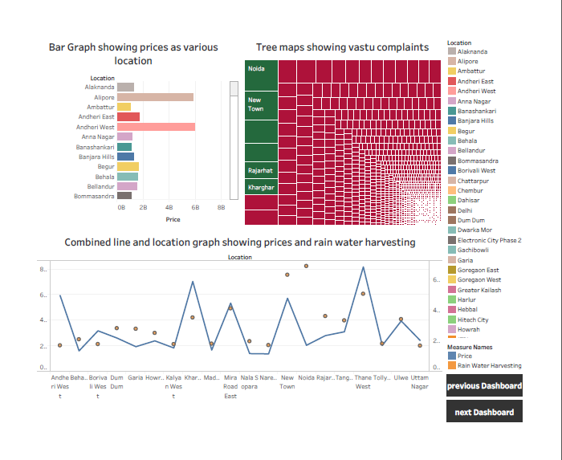

Slide 23
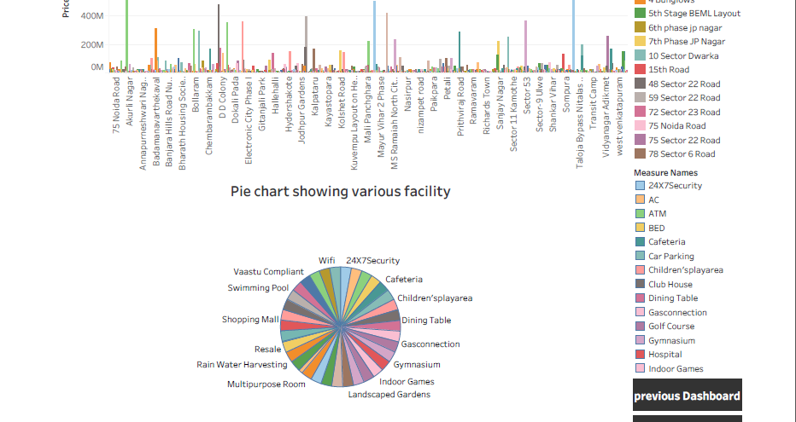

Slide 24
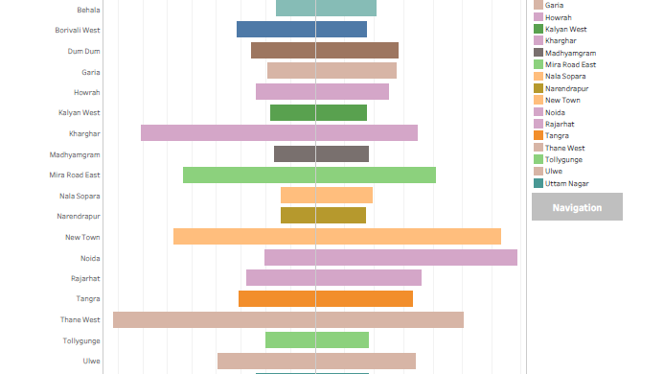

Slide 25

STORY

Slide 26
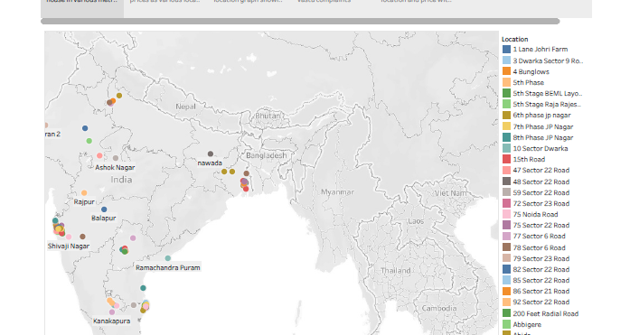

Slide 27

Application :
House price prediction in a metropolitan city in India is a valuable solution for potential home buyers, real estate agents, and investors. By leveraging historical sales data, property details, and location-specific information, a predictive model can accurately estimate house prices.

Slide 28

Conclusion :
Based on the criterion of price convergence, house prices in the 15 metropolitan cities do not converge to the LOOP. This implies that the housing markets in the different areas operate as segmented independent local markets

Slide 29

THANK YOU

